Slide 1
Detection and distance
measurement of speed bumps
1556122 林侑贞
1556123 梁俊华
1556124 岑健平

Slide 2
Tools
Yolo v2 from pjreddie/darknet (training on linux)
Yolo v2 from AlexeyAB/darknet for Windows
Yolo Mark from AlexeyAB/Yolo_mark to mark data
OpenCV & CUDA
Visual studio 2017 & C/C++ (coding & testing on Windows)
Camera & chessboard.

Slide 3
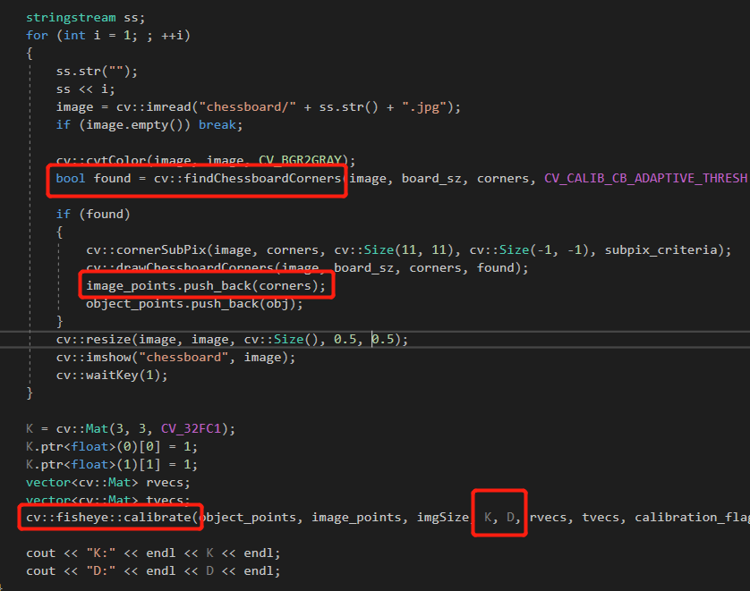
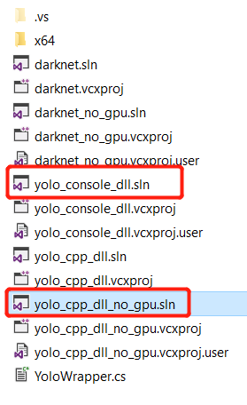
1.Fisheye Calibration
https://github.com/AlexeyAB/darknet

Slide 4
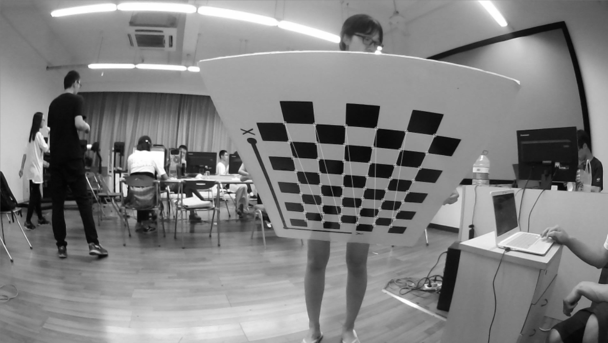
1.Fisheye Calibration

Slide 5
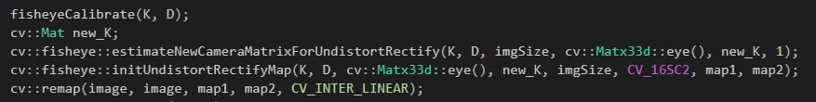
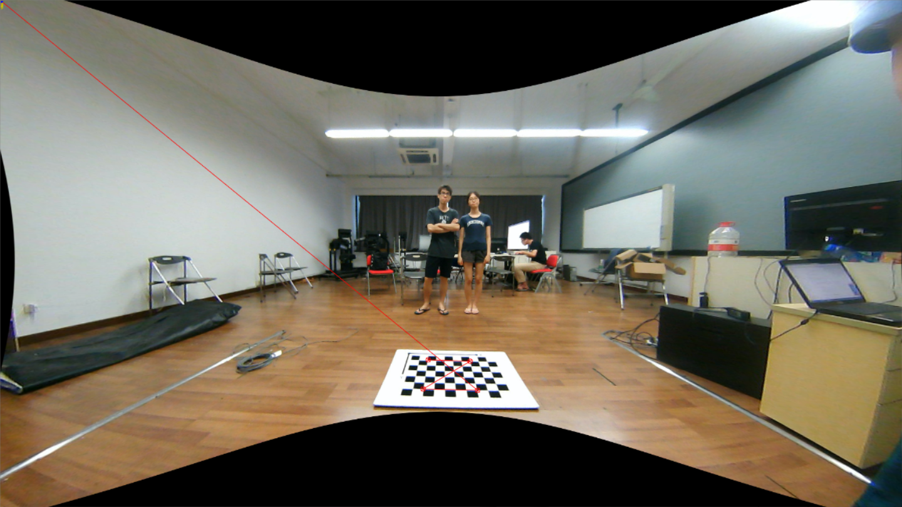
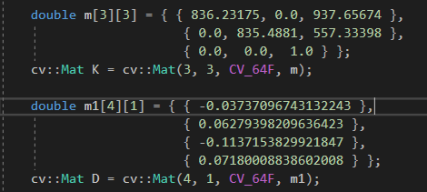
K & D

Slide 6
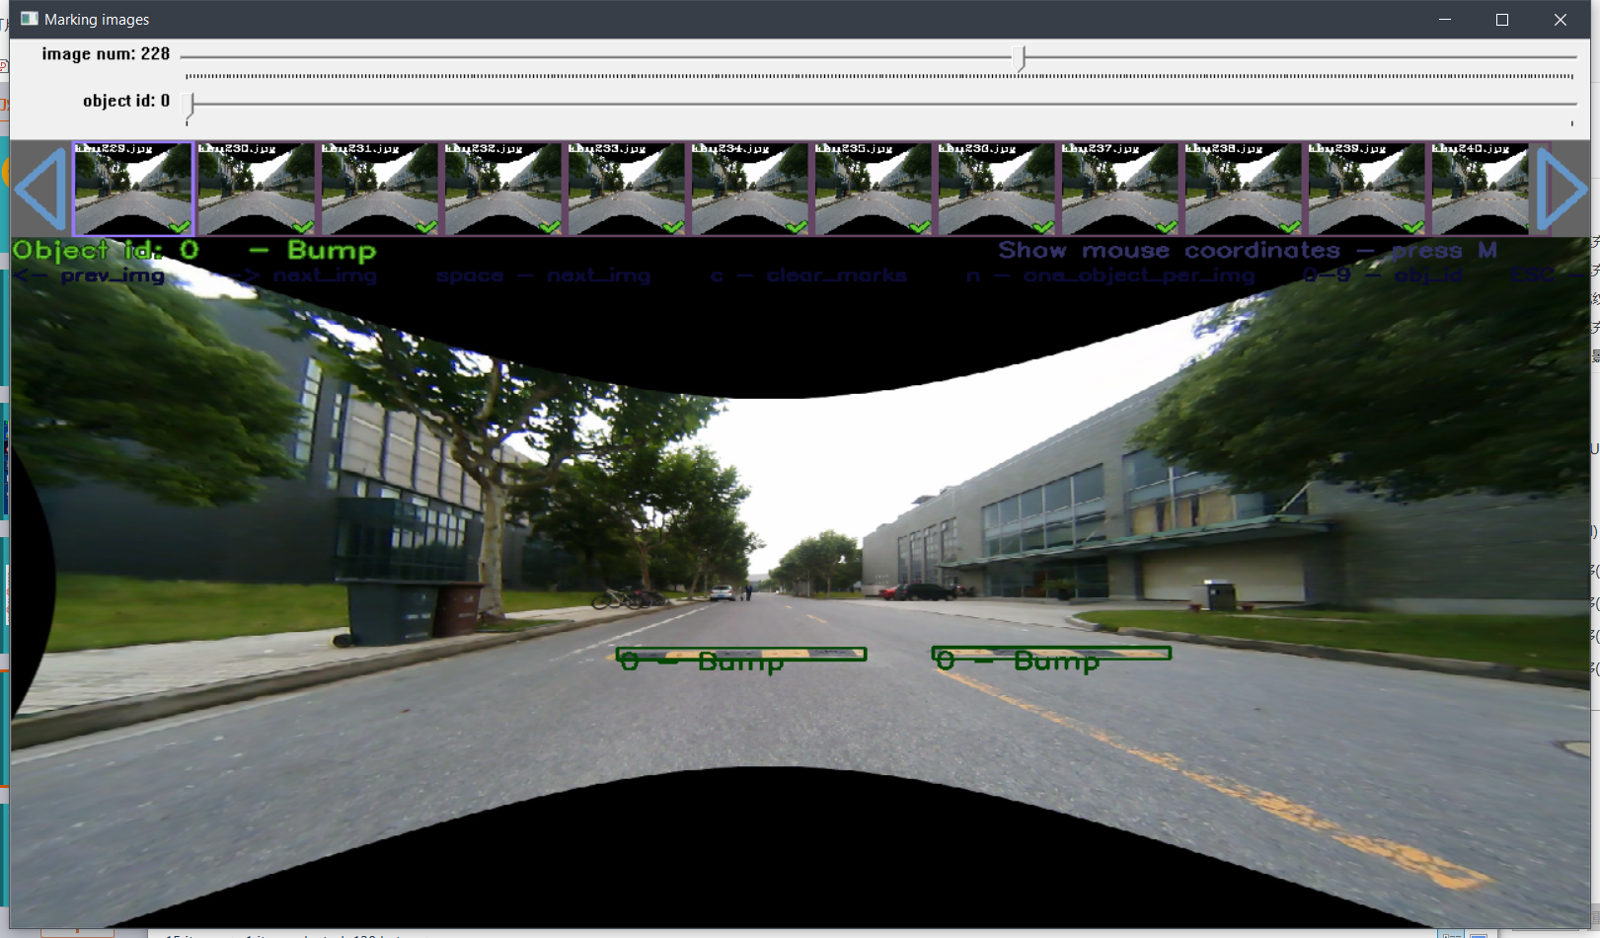
2. Marking 1300 images and train

Slide 7
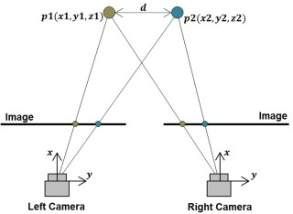
3.Distance Mesuring
stereo camera distance measurement
two camera
using visual disparity to measure distance
Single camera distance measurement
measure objects distances on a flat plane.
objects should not leave the plane
using Perspective Projection transform to measure distance

Slide 8
3.Perspective Projection transform
obseving from the top

Slide 9
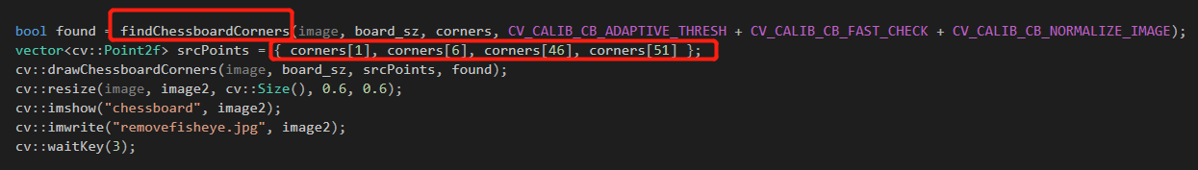
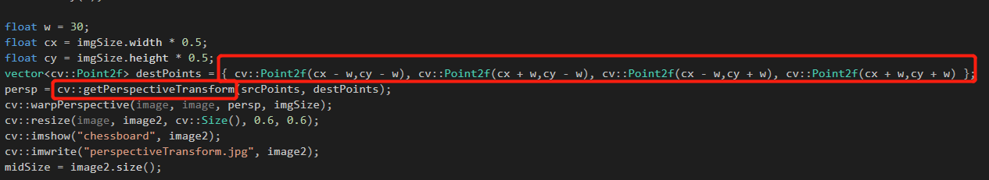
3.Perspective Projection transform

Slide 10
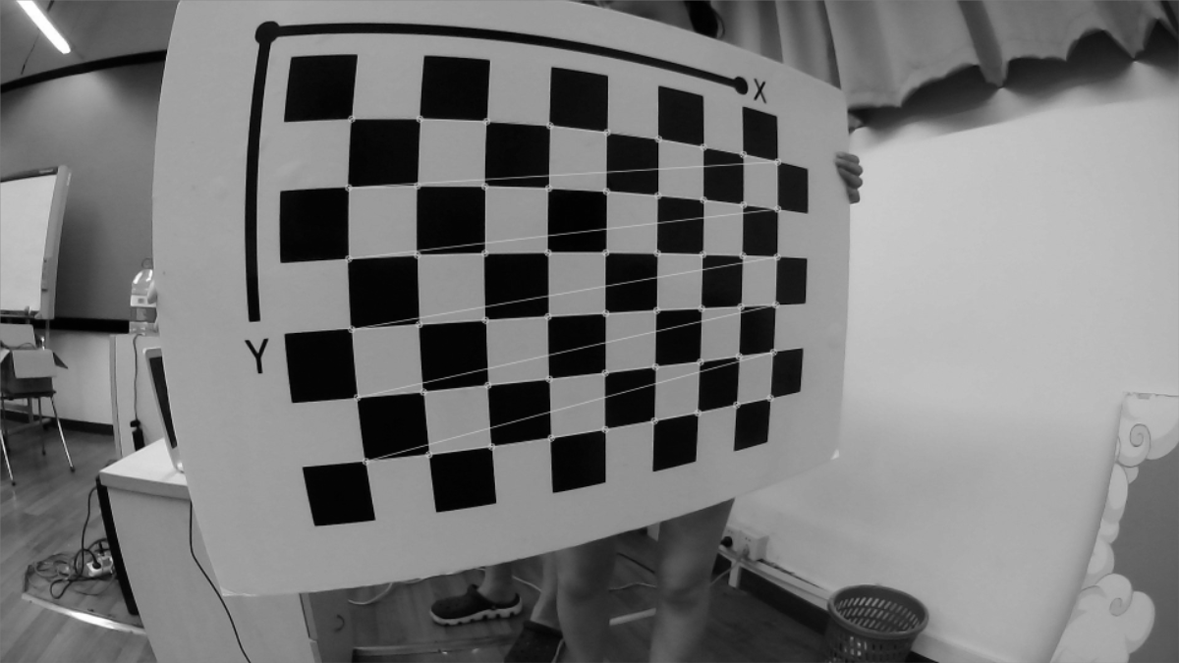

Slide 11
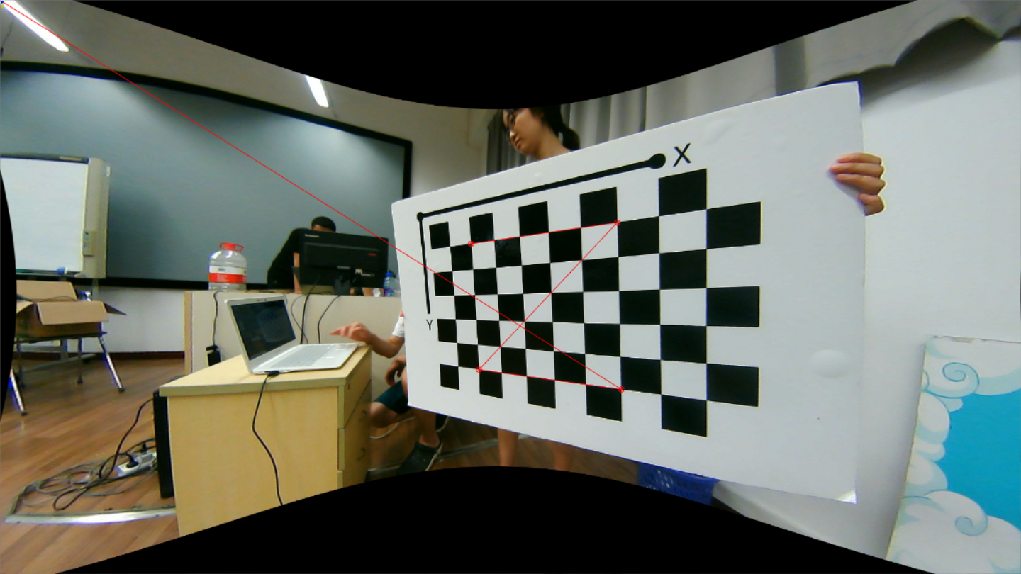

Slide 12
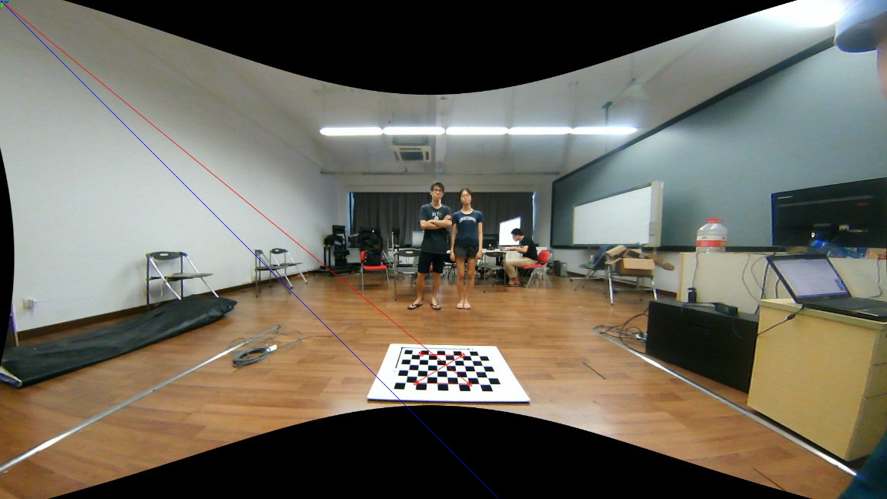

Slide 13
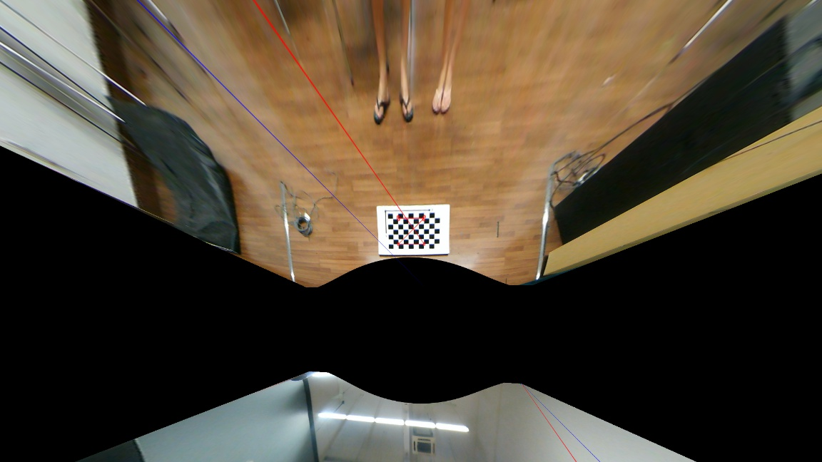

Slide 14
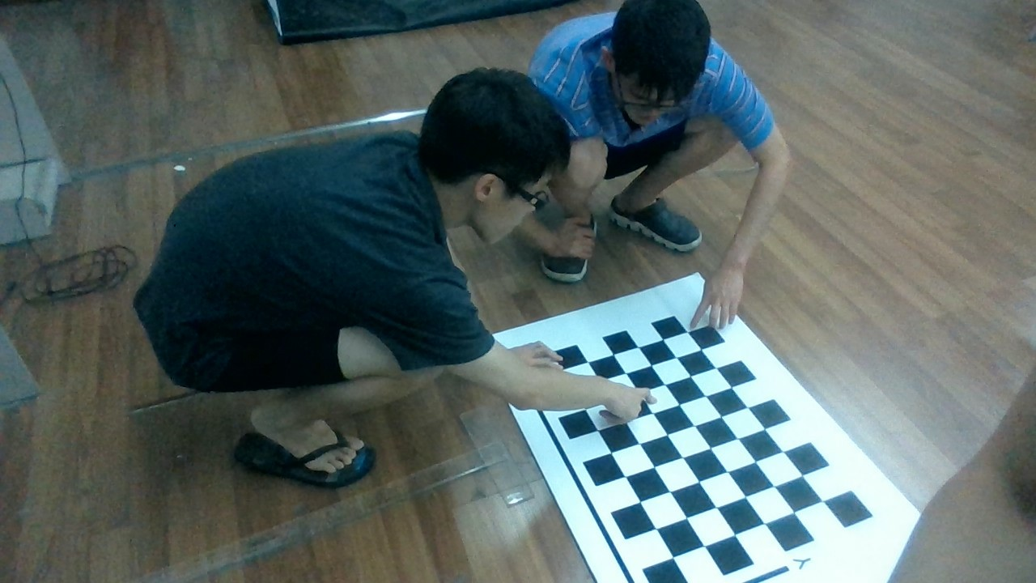
3.Perspective Projection transform

Slide 15
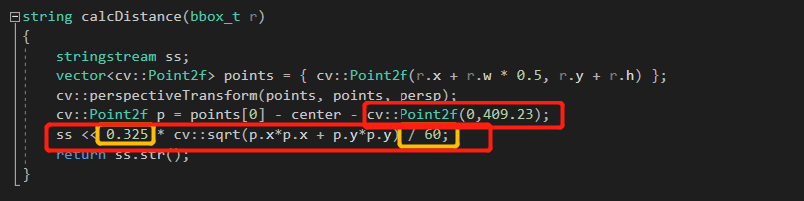
3.Perspective Projection transform

Slide 16
